Slide 1
Relational Databases
Key Concepts:
Data and Metadata
Tables
Rows, Columns, Attributes
When does one attribute determine another?
Keys
Candidate Keys, Primary Keys, Foreign Keys
Entity Integrity
Referential Integrity
Nulls
System Catalog
Indexes

Slide 2
Relations and Tables
A relation is a set of related items.
A relational database represent a relation using a table (or "entity set“ or “entity”) of rows and columns.
Each row (or tuple) represents a single entity instance or entity occurrence or element or record.
Each column represents an attribute (or field).
The columns have distinct names.
Each attribute has a type (e.g. integer, string) or a range of valid values (the "attribute domain").
All values in a column must be the same data type.
No two rows can be identical – "entity integrity".
There must be some combination of attributes that uniquely identifies each row.
Order of the rows and columns is irrelevant.

Slide 3
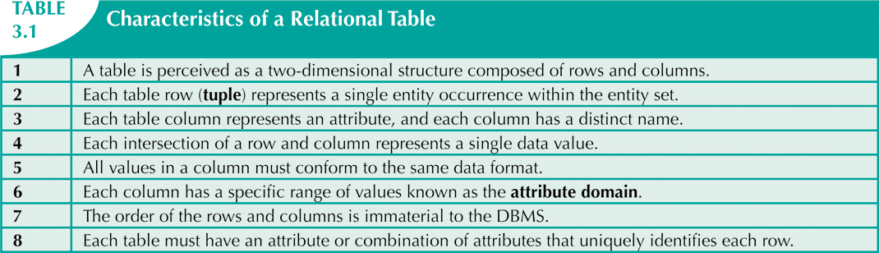
Characteristics of a Relational Database

Slide 4
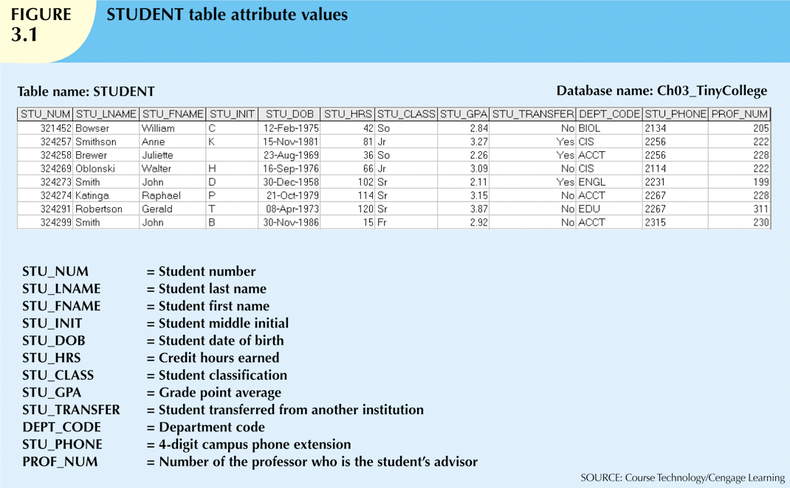
Database Table Example
Data
Null value
Metadata

Slide 5
One Attribute Determines Another
An attribute (or set of attributes) X determines an attribute (or set of attributes) Y if given any 2 rows that have the same values for X, those rows also have the same values for Y. In this case we say that Y is dependent on X, written X -> Y.
X is the determinant and Y the dependent.
E.g. from the table on the previous slide:
STU_NUM -> STU_LNAME
STU_NUM -> (STU_LNAME, STU_FNAME, STU_GPA)
(STU_LNAME, STU_FNAME, STU_INIT) -> (STU_DOB, STU_GPA)
……
NOTE: Dependence results from the rows that happen to be in the table. It does NOT imply causality.
Any attribute with unique values determines all other attributes.

Slide 6
Determining Dependence
How to determine if an attribute, say X, determines another attribute, say Y?
Look for different rows where the value of X is the same.
If, for ANY such case, the value of Y is different, then X does NOT determine Y.
If this never happens, then X determines Y.
X determines Y if, every time 2 rows have the same X, they also have the same Y.
We will see later how to issue a query to get this, rather than doing it manually.

Slide 7
Keys
A superkey is any set of attributes that uniquely identifies each row, i.e. determines all other attributes.
NOTE: Any set of attributes containing a superkey is also a superkey.
A candidate key is a superkey without any unnecessary attributes; i.e. a superkey which does not remain a superkey if any attribute is removed.
NOTE: Any column with unique values is a candidate key.

Slide 8
Primary Key
A primary key (PK) is a candidate key selected to uniquely identify each row.
The PK provides "entity integrity" – each row is unique.
The values in a PK must be unique.
Every table in a relational database must have one primary key.
If there is more than one candidate key, select one to be the primary key.
Make your choice based not only on what rows happen to be in the table, but on what additional rows might be added.
Candidate keys other than the PK are known as alternate keys.

Slide 9
Nulls
A null is a missing value (NOT zero or space).
Nulls should be avoided as much as possible, but real data sometimes contains them.
A value may not exist or may exist but be unknown.
"Dummy" or flag values can sometimes be used to avoid nulls.
E.g. "None" for a missing name.
Can create problems when writing code; have to know the exact string; also when functions such as COUNT and AVERAGE are used or when database tables are linked.
Nulls give rise to three-valued logic – if something is not true it is not necessarily false.
E.g. if Bob's phone number is null, is the statement
“phone_number = 555-1212”
true or false for Bob? Neither, it is unknown.
A PK may not contain nulls.

Slide 10
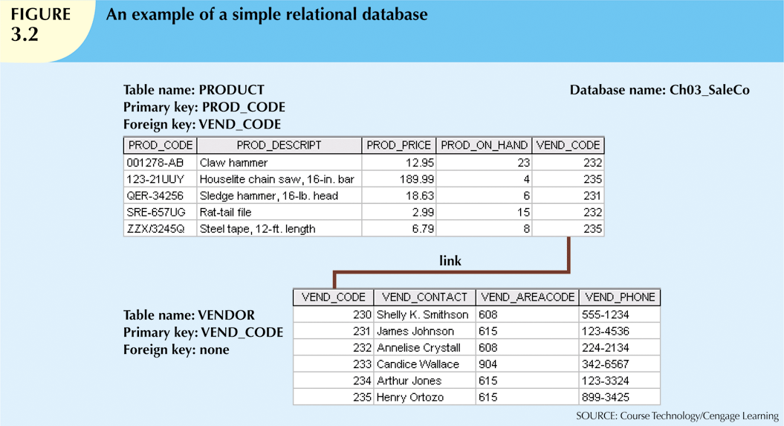
Foreign Key
A foreign key (FK) is a column (or set of columns) whose non-null values come from a primary key column (or set of columns) of another (or the same) table.
Every foreign key value must be either null or a valid value in the primary key of the related table.

Slide 11
Referential Integrity
Foreign keys provide "referential integrity" – every non-null value of a foreign key attribute must be a valid value in the table where that foreign key is a primary key.
This ensures that when one row refers to another row, that reference is valid.
Note that the reverse is NOT true – the primary key column may contain values that are not in the corresponding foreign key.
E.g VEND_CODE 230 on the previous slide.
Note that foreign keys duplicate data (E.g. two VEND_CODE 232’s on the previous slide). But they make the relational database model work by enabling tables to be linked together by sharing a common attribute.
Redundancy exists only when there is unnecessary duplication of data.

Slide 12
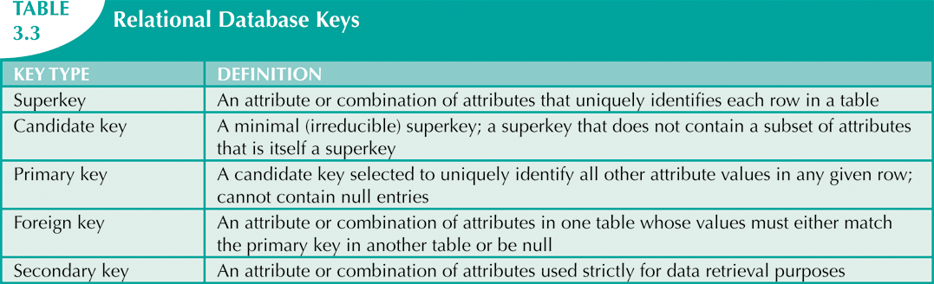
Keys
A table has exactly one primary key.
A table may have none, or more than one foreign key.

Slide 13
System Catalog
The system catalog (or data dictionary) contains metadata that describes the database.
All attribute names and characteristics.
PKs, FKs and their relationships.
Table creation information (date, author, etc).
Access information (authorized users and their privileges).
The system catalog is itself stored in a database created by the system.
This allows the DBMS to check for issues like:
Homonyms – same name is used to label different attributes in different tables.
E.g. C_NAME might mean customer name in one table and consultant name in another.
Synomyms – different names used to refer to the same thing in different tables.
E.g. CAR and AUTO.

Slide 14
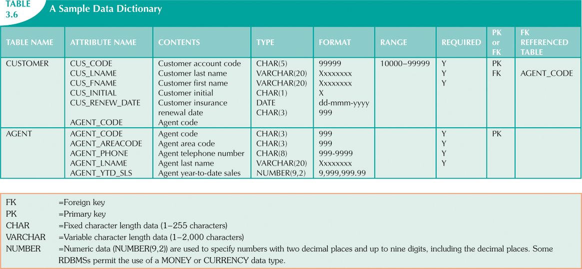
Example System Catalog

Slide 15
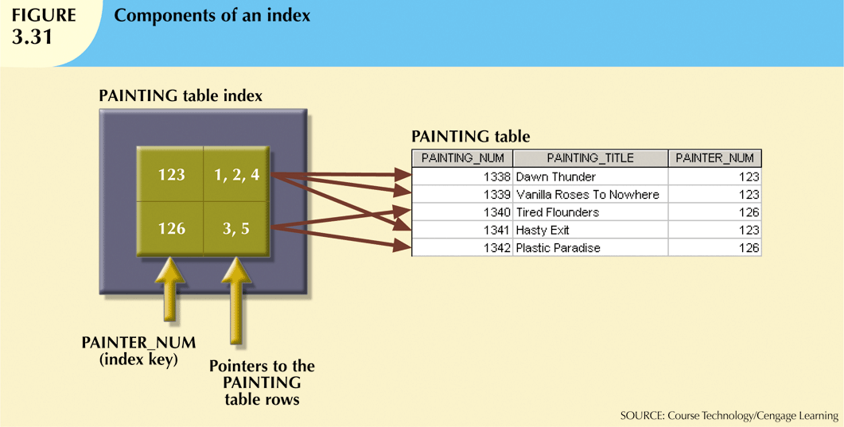
Indexes
An index allows a row containing a particular value to be found quickly without searching through all the rows of the table.
Just like an index in a book.
An index normally consists of an ordered list of keys and pointers.
The pointers reference the rows containing the key.

Slide 16
Indexes (ctd)
A unique index is an index in which the index key can have only one pointer value (row) associated with it.
DBMS automatically creates a unique index on the primary key when a table is created.
Database designer can create additional indexes.
E.g index on customer last name will allow for easy retrieval of customer data alphabetically by last name.
A table can have many indexes.
Each index is associated with only one table.

